Slide 1
Shake’n Pour Sales Deck
Classic RTD Cocktails & Long Drinks
UNC One Corp.
Premium Cocktails. All classic, natural, kosher, vegan, non-GMO and produced according the IBA recipe
recommendations. A revolutionary ready-to-drink cocktail brand by UNC One Corp.

Slide 2
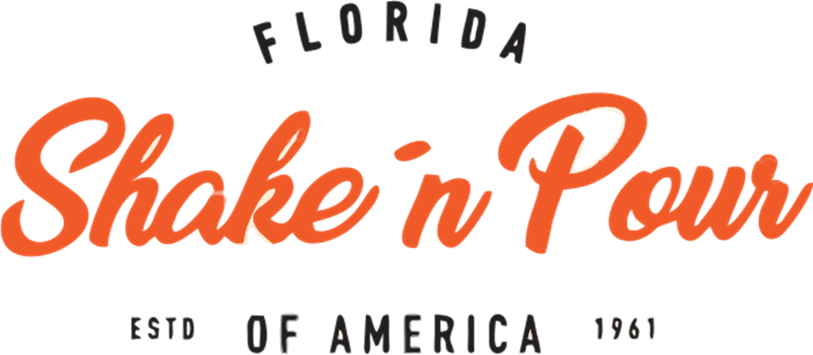

The Brand
3104 Santa Barbara Blvd. · Suite 105 · Unit 402 · Cape Coral · FL 33914 · USA
Phone: +1 (239) 810-7941 Fax +1 (239) 214-0278 www.unccorp.net · info@unccorp.net

Slide 3
SHAKE’N POUR Cocktails & Long Drinks
Premium Cocktails. All classic, natural, kosher, vegan, non-GMO and produced according the IBA recipe recommendations.
Elevating the RTD Market
A revolutionary ready-to-drink cocktail brand by UNC One Corp.

Slide 4
The RTD Cocktail Market is Booming, But Boring
The Goal:
Consumers want quality & experience: They’ve moved beyond sickly-sweet, artificial-tasting pre-mixes.
They crave premium, bar-quality cocktails but lack the time, skills, or ingredients to make them.
Existing solutions fail:
Canned Cocktails: Often flat, diluted, and compromise on aroma.
Bottled Pre-Mixes: Require adding your own spirit (inconvenient) and still lack fresh character.
Convenience
There is a clear gap for a convenient, premium product that delivers the authentic sensory experience of a fresh-shaken cocktail.
1
2
3

Slide 5
Our Solution
Introducing Shake’n Pour: The First Truly "Shaken" Ready-to-Drink.
We don't just mix—we emulate the bartender's ritual in a proprietary, patent-pending packaging system.
The Magic is in the Method:
1
Premium Ingredients Inside: Pre-measured, high-quality spirits, real citrus juice, house-made syrups, and botanicals.
Manufactured: according the IBA recipe recommendations
4
Pour & Experience: Unleashes a perfectly aerated, chilled, and integrated cocktail with a professional-quality foam and aroma.
2
Value Proposition: Bar-quality craft cocktails, with the convenience of a pantry staple.
3
The "Shake" Chamber: A unique internal mechanism activated by the consumer.

Slide 6
The Product & Technology
How It Works: Simple, Engaging, Theatrical.
1
Store: Shelf-stable. No refrigeration needed.
2
Chill: Place bottle in freezer for 20 mins or fridge.
3
Shake: Activate the internal mechanism with a simple, satisfying shake.
4
Pour & Enjoy: Experience the perfect cocktail, instantly.

Slide 7
Line-Up
1
Alcoholic Cocktails & Long Drinks
Big Apple 5.5% or 10% AbV
Long Island Iced Tea 5.5% or 22% AbV
Mai Tai 5.5% or 13% AbV
Tequila Sunrise 5.5% or 13% AbV
Cuba Libre 5.5% or 13% AbV
Piña Colada 5.5% or 5.5% or 13% AbV
Strawberry Margarita 5.5% or 13% AbV
Non-Alcoholic Cocktails
Virgin Big Apple
Virgin Mai Tai
Virgin Tequila Sunrise
Virgen Piña Colada
Virgen Strawberry Margarita
.
2

Slide 8
Target Market
We Target the Aspirational, Time-Poor Connoisseur.
1
Primary: "The Home Entertainer“
Age 28 - +45, urban/suburban.
Values quality, loves to host, seeks impressive yet effortless solutions.
Willing to pay a premium for experience and convenience.
2
Secondary: "The Convenience-Seeking Gourmet"
Age 25 - +40.
Enjoys premium products but has limited time. Shops at premium retailers.
Seeks an instant reward and a moment of sophistication.

Slide 9
Market Size
Steady growing potential
Global RTD market projected to reach $45B by 2027* (CAGR 14%).
Premium & super-premium segments are the fastest-growing.

Slide 10
Competitive Advantage
Why We and Win: A Multi-Layered Moat.
Feature | Shake’n Pour | Standard Canned Cocktail | Premium Bottled Mix
Experience | Authentic "shaken" texture & aroma | Flat, one-dimensional | Mixed texture, lacks aeration
Convenience | Complete, all-in-one, no tools | Complete | Requires separate spirit
Quality | Fresh citrus, real ingredients, premium spirits Vegan, Kosher, 100% Natural, non-GMO | Often from concentrate, lower-proof spirit, mostly artificial ingredients and preservatives | Varies; often high-quality, mostly artificial ingredients and preservatives
Theatre & Brand | Engaging ritual, memorable unboxing | Functional, mundane | Functional
Shelf Stability | Yes (no preservatives needed) | Yes | Often requires refrigeration

Slide 11
Business Model & Go-to-Market
Scalable, Multi-Channel Revenue Strategy.
Direct-to-Consumer, Premium On-Premise, Off-Premise.
DTC Website: Full margin sales, data capture, brand storytelling.
Hospitality Accounts as a premium, consistent, and fast "signature" option.
Expand Retail & Partnerships
Premium Retail: Partnerships with high-end grocery chains - Europe (e.g., Kaufland, Edeka, Globus, Wasgau and other customers).
Hospitality Industry
Gas Stations, Truck-Stop Stores
Luxury & Travel: Duty-free, luxury hotels, private member clubs.
Subscription Model: "Cocktail Club" monthly delivery.

Slide 12
Marketing & Brand Strategy
1
Building an Iconic Lifestyle Brand.
2
Core Message: "The Bar is Open. Anytime."
Key Initiatives:
Influencer & Creator Campaigns: Seed product with mixology and lifestyle influencers to demonstrate the "shake" ritual.
Digital-First Storytelling: High-quality video content showcasing the product theatre and versatility.
Strategic Partnerships: Align with premium food, design, and fashion brands.
Sampling at Events: Target high-end cultural, culinary, and sporting events.
Brand Aesthetic: Sophisticated, minimalist, bold. A blend of modern design and classic cocktail artistry. Highly convenient!

Slide 13
The Team & The Ask
UNC One Corp: Proven Expertise.
Leadership: Seasoned professionals from spirits branding, FMCG marketing, and food & beverage operations.
Advisors: Include award-winning mixologists and packaging engineers (part of the team).

Slide 14
Vision & Call to Action
Our Vision: To become the global leader in premium, experience-driven RTD cocktails, synonymous with quality and innovation.
Join Us in Shaking Up an Industry.
Let's build the future of cocktails together.

Slide 15
Contact
The Leadership
Dr. Mabel Rusch, CEO & President, Phone: +1 (239) 214-8290 mabel@unccorp.net
Uwe Rusch, Entrepreneur & Beverage Scientist Commercial Team info@unccorp.net
Ed Rodriguez, National & International Sales ed.rodriguez@unccorp.net Phone: (786) 229-6178net

