Slide 1
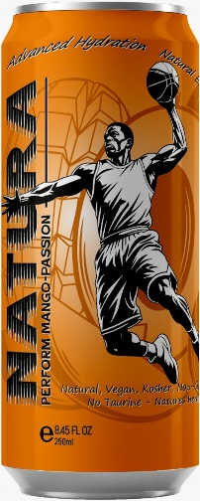
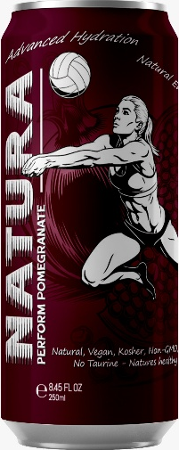
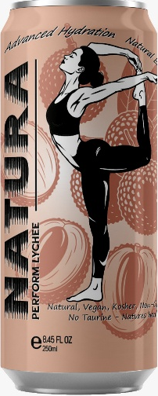
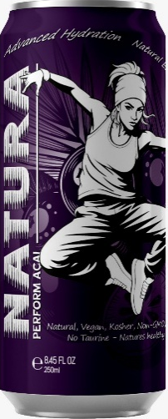
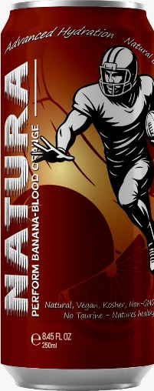
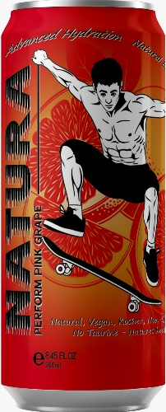
NATURA Perform
Introducing NATURA Perform. The ultimate 100% natural Sports- & Health drink for peak physical and mental performance!
Engineered in the United States of America.

Slide 2
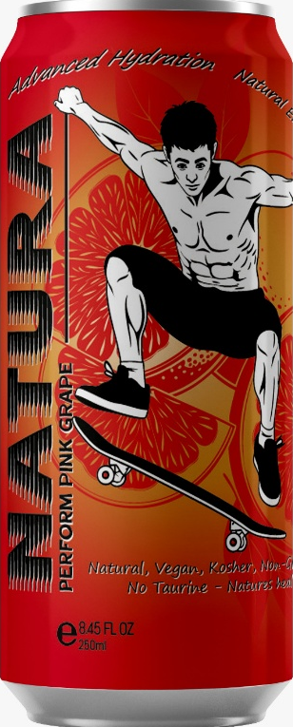
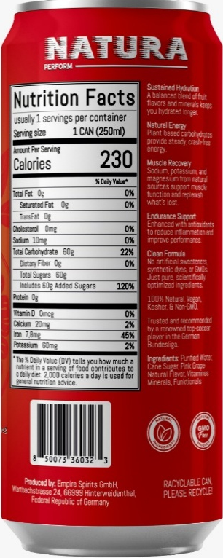
Introduction
Elevate your game the natural way with NATURA Perform, a high-performance sports-energy drink designed to fuel your body with pure, clean ingredients. Engineered for Athletes and Power People who demand both power and purity, our formula delivers optimal hydration, sustained energy, and essential electrolytes—all without artificial additives, colors, caffeine, taurine or artificial sweeteners. designed For athletes, people with highly active mental challenges, and people who want to recharge their energy in a healthy way!

Slide 3

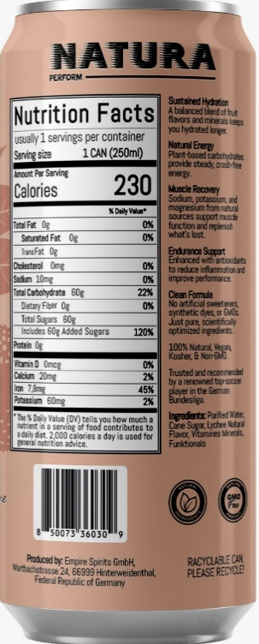
Benefits of NATURA Perform
01
Sustain Energy.
Hydration and Electrolytes.
Vitamins and Minerals.
Bio-Functionals.

Slide 4
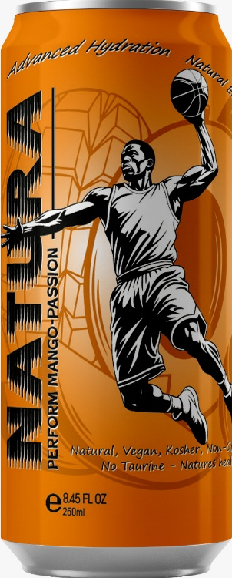
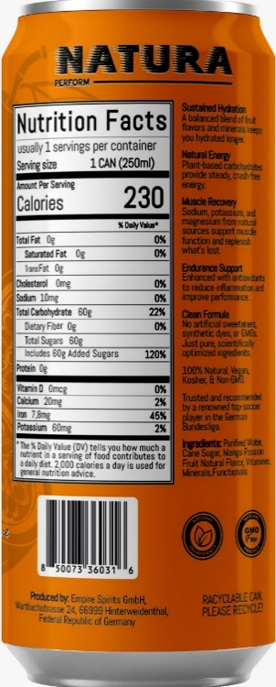
Advanced Hydration
NATURA Perform combines natural bio active ingredients with essential electrolytes to ensure prolonged hydration. Say goodbye to dehydration during your physical and mental workouts and welcome natural, better performance without artificial additives.

Slide 5
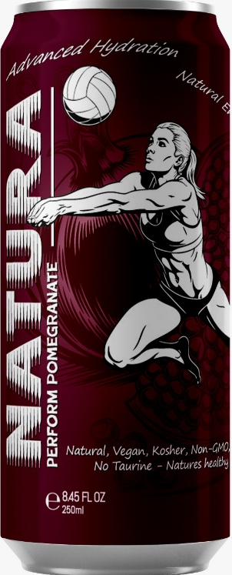
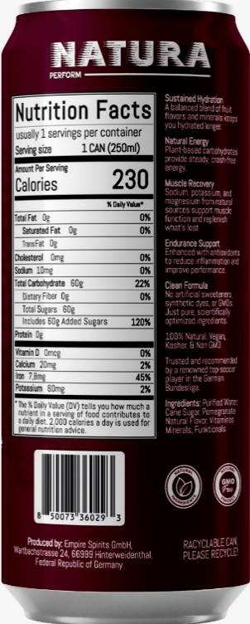
Sustained Energy. Zero Compromises
Stop choosing between explosive power and a clear conscience. Our natural pre-workout is engineered to deliver: Natural Energy Lift Experience a smooth, jitter-free surge of energy from nature, not synthetic stimulants. Unmatched Power Pump Boost nitric oxide production with nitrate-rich beetroot extract and citrulline for increased blood flow, oxygen delivery, and muscle pumps. Laser Focus Sharpen your mental clarity and drive with naturally-sourced compounds that enhance cognitive function without the crash. Superior Endurance Fight fatigue at the cellular level with powerful ingredient, helping you push harder, longer.

Slide 6

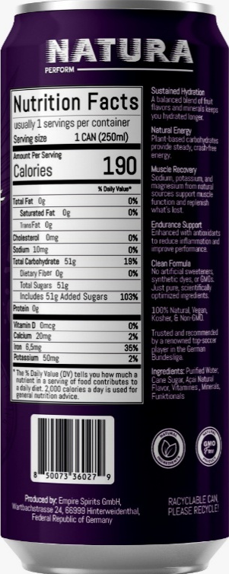
Available in 6 Refreshing Flavors
organic functional substances
organic functional substances
Lychee, Banana Blood-Orange, Açai, Pomegranate, Pink Grape, Mango-Passion, NATURA Perform – Pure Fuel for the Relentless. When every second, every rep, and every mile, high concentration count, your body deserves clean, powerful hydration—free from shortcuts. Introducing NATURA Perform, the all-natural sports- and health drink crafted for endurance athletes, CrossFit competitors, and high-intensity trainers, high mental stressed people with active lifestyle and who refuse to compromise. Engineered for the Demanding Athlete: Highly Mental Active People Sustained Energy, Naturally, Natural ingredients and real fruit sugars provide long-lasting fuel, avoiding the crash of artificial energy drinks. Elite Hydration A precision of organic functional substances + electrolyte complex (sodium, potassium, magnesium) combats muscle cramps and fatigue during grueling sessions. Recovery-Enhancing Superfoods Bio for inflammation, ginger for digestion, and Himalayan pink salt for mineral replenishment—because real endurance starts after the workout. No Junk, Just Performance, Zero artificial sweeteners, dyes, or synthetic additives—just science-backed, bio-powered ingredients.

Slide 7


02
Target Audience
Mentally Highly Active Individuals,
Athletes, and Health-Conscious People.

Slide 8
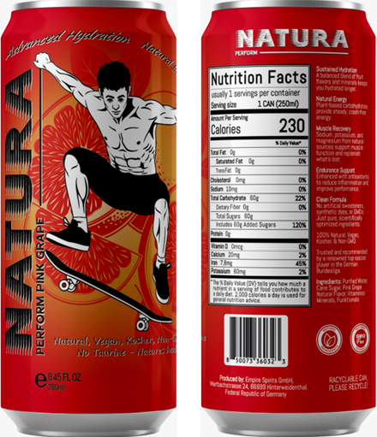
The NATURA Perform Difference
Synergy of Science Nature: We don’t just use artificial ingredients; we smartly use only natural ingredients. Our formulations are based on clinical research to ensure optimal efficacy and bioavailability. Beyond Sustainability: We are regenerative. From sourcing to shipping, our process is designed to give back to the environment, ensuring the ecosystems that provide our ingredients thrive for generations. The No-Crash Promise: Feel the power of nature without the artificial spike and debilitating crash. Our energy is clean, sustained, and designed to support your entire session and recovery.

Slide 9
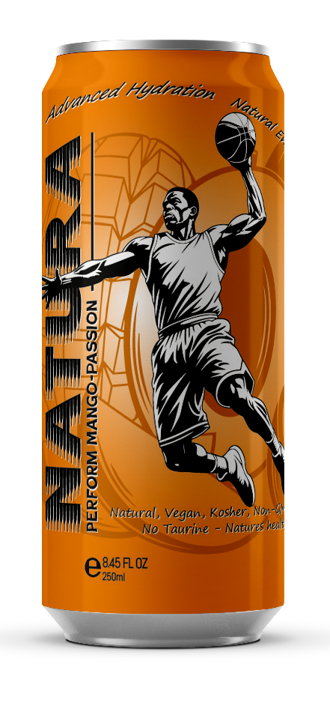
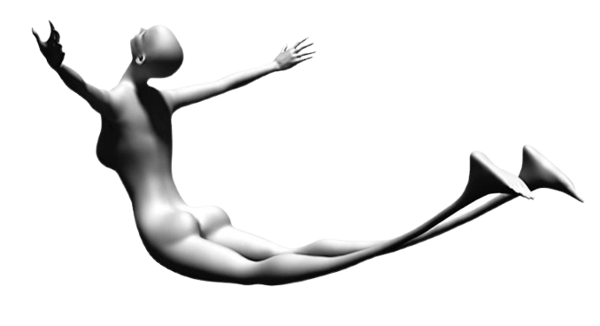
Your body is a temple.
Fuel it like one
Plant-Powered Pre-Workout.
Zero Artificial Junk.
Zero Caffeine Content.
Zero Taurin Content.
Zero Cardiovascular Stress.
Zero Anxiety Nervousness.
No Dependence and Withdrawal. Regular consumption does not lead to dependence.
No Insomnia. No Artificial Sweeteners. Contains Creatine NATURA Perform is a real Sports- Health Drink.
Kind to Your Body!
Consuming most commercially available Energy Drinks, especially later in the day, can severely disrupt sleep patterns, leading to a cycle of fatigue.

Slide 10
Benefits of NATURA Perform
NATURA Perform: Fuel Your Nature
NATURA Perform: Nature's Fuel. Your Edge
Perform at Your Peak. Naturally
Pure Hydration. Peak Performance
Your Body's Natural Request
Benefit-Driven & Direct
Sustain Energy. Accelerate Recovery. Naturally
Hydration and Electrolytes, Powered by Nature
More Than Hydration: Natural Energy + Rapid Recovery
The Natural Edge for Your workout and Your Health
Replenish What You Lose. Fuel What You Do.
"Health Drink" Focus (Broader Audience)
Elevate Your Active Lifestyle - The Natural Way
Daily Hydration, Amplified with Natural Nutrients
For the Gym and Beyond: Natural Wellness in Every Sip
Nourish Your Body’s & Brains Momentum
The Clean, Natural Way to Stay Energized and Hydrated
Premium & Sophisticated Where Nature Meets Performance
Engineered by Nature, Designed to Perform
The Art of Natural Replenishment
Unlock Your Potential with Nature's Formula

Slide 11


Conclusions
NATURA Perform stands out as the uncompromising choice for athletes, health-conscious individuals, and mentally highly active people. With its natural ingredients, you can fuel your body effectively while enjoying peak performance, without harming your health. Choose NATURA Perform—because your goals deserve pure fuel for relentless success.

Slide 12
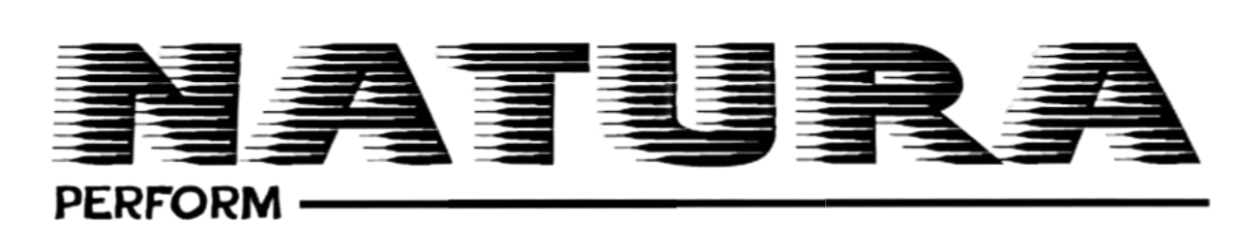

Thank you!
Do you have any questions?
Phone: +1 (239) 966 77 88 www.unccorp.net Fax: +1 (239) 214-0278 info@unccorp.net

